Slide 1


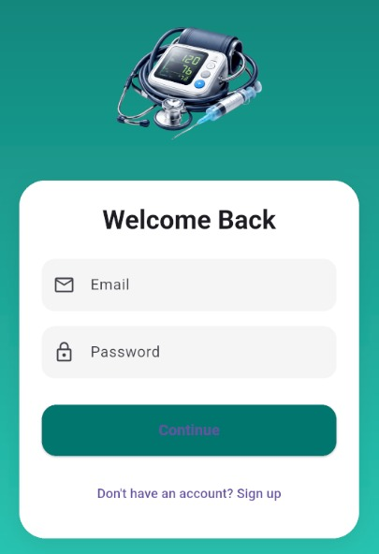
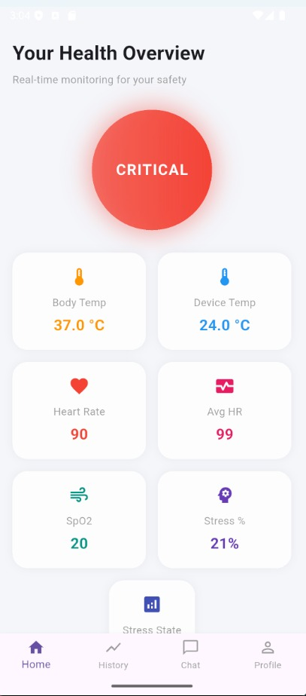
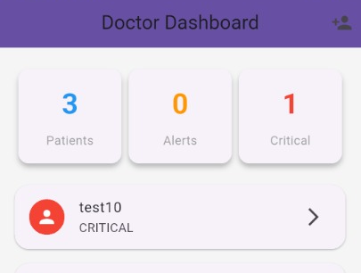
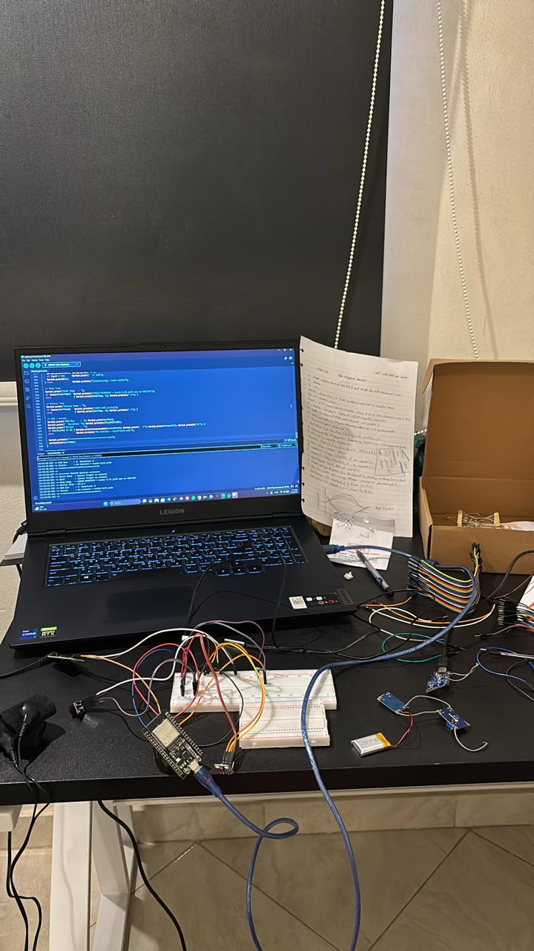
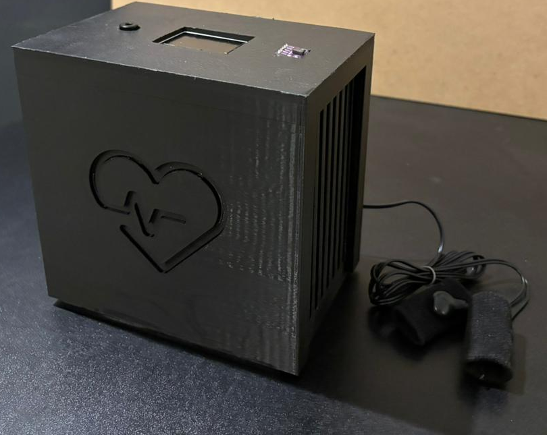
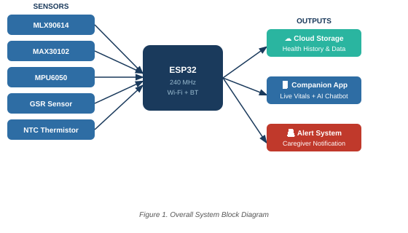
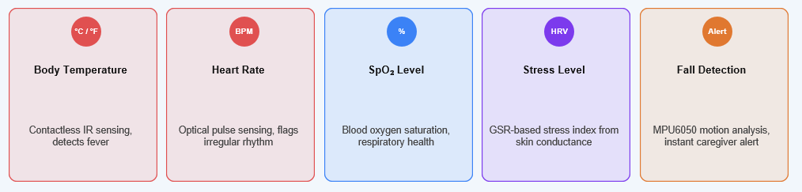

ELDERLY-SMART HEALTH MONITORING SYSTEM
Carol Maged, Malak Ikramy, Mai Gamal, Saif Abdelhaleem, Motaz Mohamed, Loay Islam
Supervised By: Dr. Moataz M. Elsherbini
Department of Communication Engineering, Benha National University(BNU)
Abstract
Software Applications (Mobile APP)
The rapid growth of the elderly population has created an urgent need for continuous, reliable home-based health monitoring. This project presents the design and implementation of the Elderly-Smart Health Monitoring System — a non-contact IoT-based device placed beside the patient that continuously measures body temperature, heart rate, blood oxygen saturation (SpO₂), and stress level, while also detecting falls.
The system leverages the ESP32 microcontroller with Wi-Fi and Bluetooth for wireless data transmission. A companion smartphone app streams live readings and stores full health history. An AI chatbot analyzes data, provides health recommendations, and predicts potential health issues. Automated alerts notify caregivers when readings fall outside safe thresholds, enhancing safety and quality of life for elderly patients
Introduction
The rapid development of embedded systems, sensor networks, and communication technologies has made healthcare monitoring a critical part of modern medical services. Traditional hospital monitoring is costly and inaccessible for continuous home use, creating a gap in elderly care.
Our system addresses this by providing a bedside device — no wearables required — that monitors four key vital signs 24/7. The device requires no technical expertise from the patient; it simply needs to be placed near them.
Unlike ordinary monitoring devices, the Elderly-Smart system adds intelligence through a companion app and an AI chatbot that not only displays readings but understands them — explaining results in plain language, detecting early warning patterns, and recommending action before a medical crisis occurs
Figure 2. APP Interface
Figure 5. Doctor’s app view
Figure 4. Vitals measures
Methods and Materials
Test & Results
The system integrates five biomedical sensors with the ESP32 DevKit V1 microcontroller:
• MLX90614 — Contactless IR temperature sensor for non-invasive body temperature measurement.
• MAX30102 — Pulse oximeter and heart rate sensor measuring SpO₂ and BPM optically.
• MPU6050 — Accelerometer and gyroscope for fall detection using motion analysis.
• GSR Skin Electrical Sensor — Measures galvanic skin response to assess stress level via sweat gland activity.
• NTC 10K Thermistor — Monitors internal PCB temperature to prevent overheating.
All sensors interface with the ESP32 via I²C, SPI, or ADC pins. The ESP32 processes data locally and transmits wirelessly to the companion app over Wi-Fi. The mobile application (Android/iOS) provides live readings, historical charts, and AI chatbot integration. Fall detection triggers an immediate push notification to the caregiver.
Sensor integration with the ESP32 was validated through Proteus circuit simulation. All five sensors responded correctly within expected ranges. The MLX90614 achieved ±0.5°C accuracy compared to a commercial thermometer. The MAX30102 measured SpO₂ within ±2% and heart rate within ±3 BPM of reference readings. The MPU6050 successfully detected simulated fall events with motion thresholds tuned to minimize false positives. The GSR sensor responded to stress stimuli with measurable conductance changes. The ESP32 maintained stable Wi-Fi transmission to the companion app with sub-second latency across all sensor channels simultaneously.
Block diagram
Figure 6. Testing Phase
Figure 7. Results
Conclusions
The Elderly-Smart Health Monitoring System successfully demonstrates a non-contact, IoT-based approach to continuous home healthcare for elderly patients. By integrating five biomedical sensors with the ESP32 microcontroller, the system achieves simultaneous real-time measurement of body temperature, heart rate, SpO₂, stress level, and fall detection — all without requiring the patient to wear any device.
The companion smartphone app and AI chatbot extend functionality beyond simple monitoring: all data is securely stored, family and caregivers can follow the patient's condition remotely from anywhere, and the AI provides personalized health recommendations and early prediction of health risks. Automated alerts ensure immediate caregiver response when any vital sign falls outside safe thresholds.
This project demonstrates an effective, cost-efficient, and dignified solution for remote elderly healthcare management, with direct potential for clinical adoption and further AI enhancement in future work.
Figure 1. Block Diagram
What It Measures
Team Members
Contact Us
Main References
Supervisor : Dr. Moataz Elsherbini
moataz.elsherbiny@eng.bnu.edu.eg
2. Hardware Design and Implementation: Saif Abdelhaleem , Motaz Mohamed
saifhalim2004@gmail.com , motazfandies11@gmail.com
3. APP and Cloud : Carol Maged , Loay Islam
carolm.sawires@yahoo.com , luay0100453@eng.bnu.edu.eg
4. AI and Chatbot: Malak Ikramy , Mai Gamal
malakikramy983@gmail.com , Maigamalfouad@gmail.com
Pantelopoulos & Bourbakis, IEEE Trans. Syst., Man, Cybern., vol. 40, pp. 1–12, 2010.
Haghi et al., Healthcare Informatics Research, vol. 23, no. 1, pp. 4–15, 2017.
Islam et al., "IoT for health care: A comprehensive survey," IEEE Access, vol. 3, 2015.
Efendi et al., "IoT-based elderly health monitoring using Firebase," Health Sci. Rep., 2025.
Espressif Systems, ESP32 Technical Reference Manual, 2023.

